Slide 1
Here are the images for the module.
As you can see I noted the pictures that I took and provided references for the ones I did not take.
If you run into trouble with getting permission to use images that are not mine, let me know and maybe I can find another source.
I think you may agree that these should be cropped as there is too much open space surrounding them.
Thanks.

Slide 2
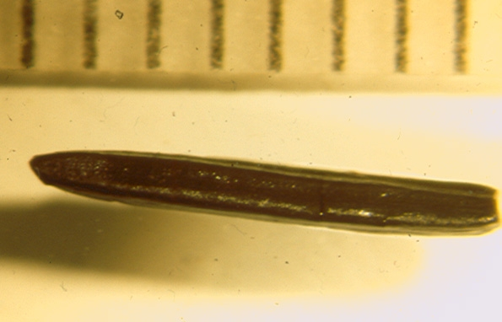
Picea (Spruce) needle
Photo by Terryanne Maenza-Gmelch

Slide 3
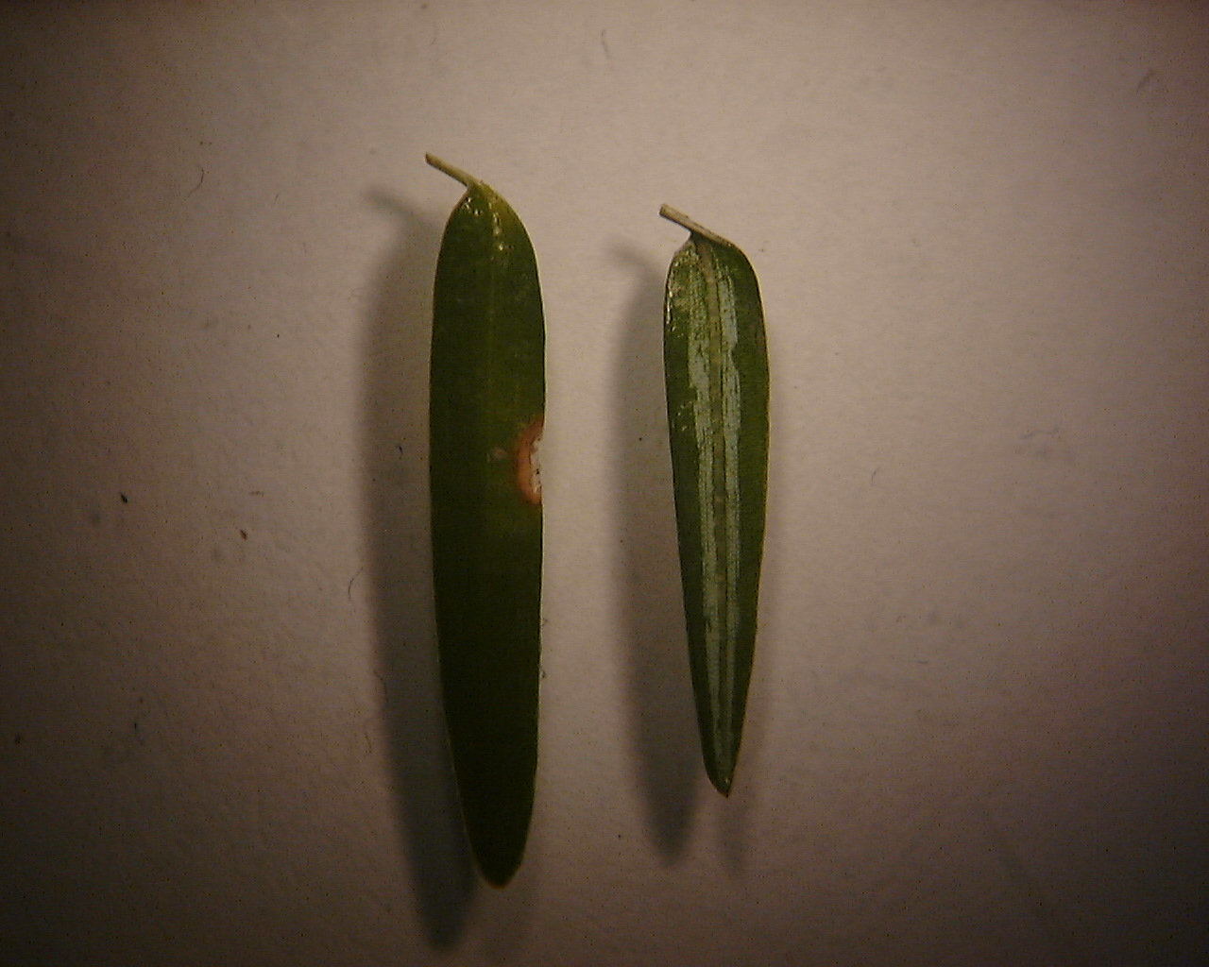
Tsuga canadensis (eastern hemlock) needles Photo by Terryanne Maenza-Gmelch

Slide 4
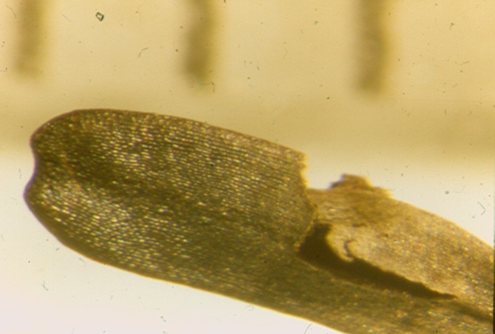
Abies (Fir) needle
Photo by Terryanne Maenza-Gmelch

Slide 5
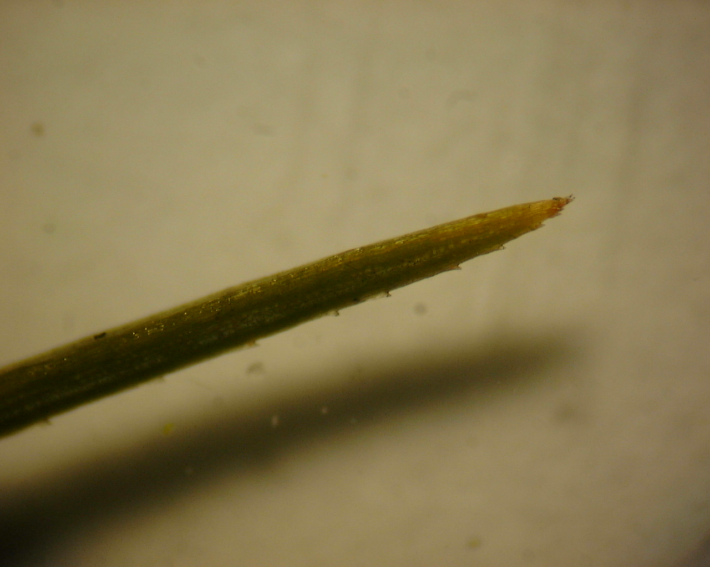
Pinus strobus (white pine) needle Photo by Terryanne Maenza-Gmelch

Slide 6
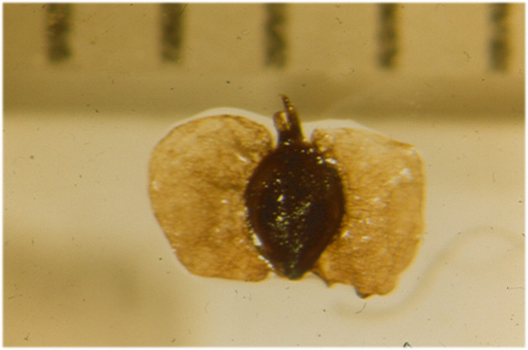
Betula papyrifera (Paper birch) seed
Photo by Terryanne Maenza-Gmelch

Slide 7
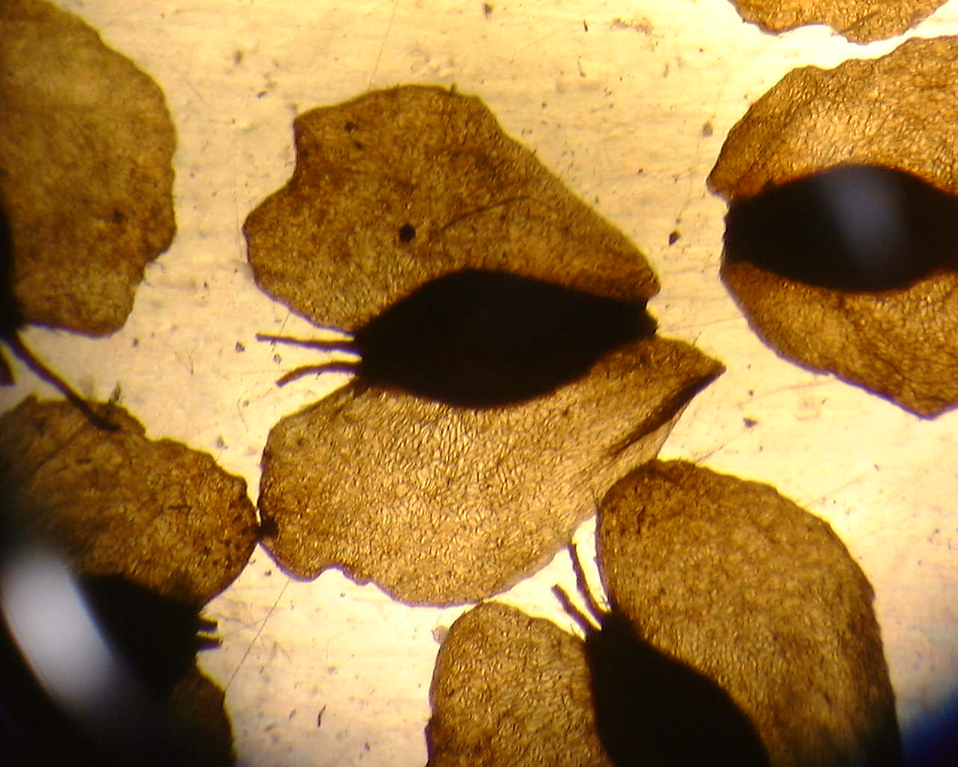
Betula populifolia (gray birch) seed
Photo by Terryanne Maenza-Gmelch

Slide 8
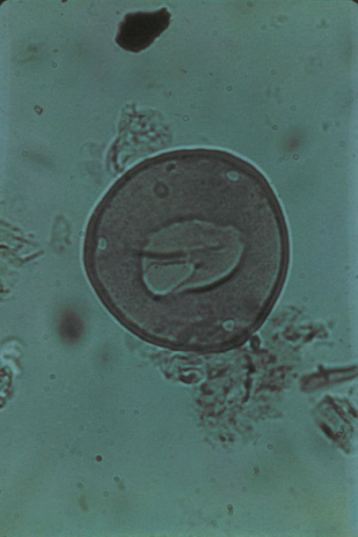
Carya (Hickory) pollen
Photo by Terryanne Maenza-Gmelch

Slide 9
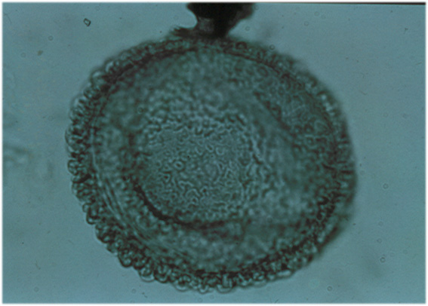
Tsuga canadensis (Eastern Hemlock) pollen
Photo by Terryanne Maenza-Gmelch

Slide 10
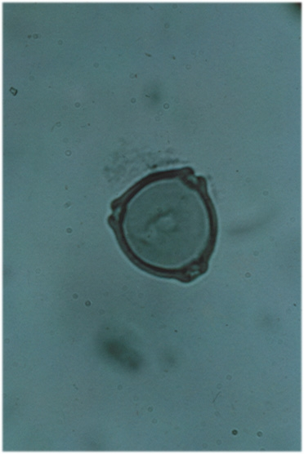
Betula (Birch) pollen
Photo by Terryanne Maenza-Gmelch

Slide 11
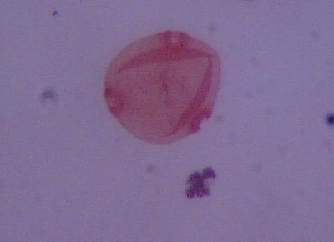
Ostrya/Carpinus pollen
Photo by Terryanne Maenza-Gmelch

Slide 12
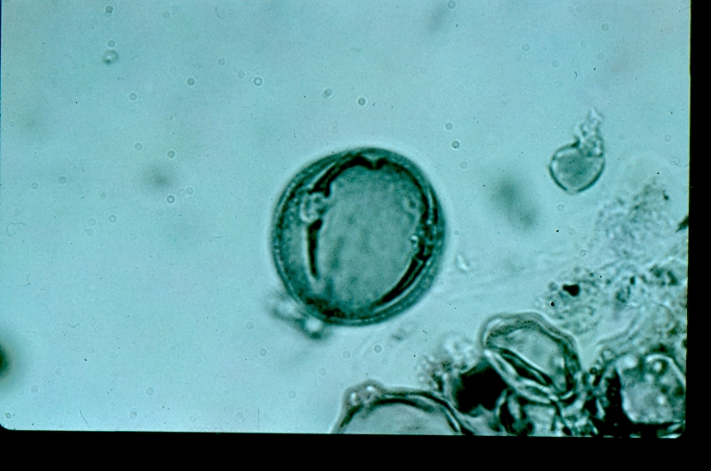
Fagus grandifolia (American beech) pollen
Photo by Terryanne Maenza-Gmelch

Slide 13
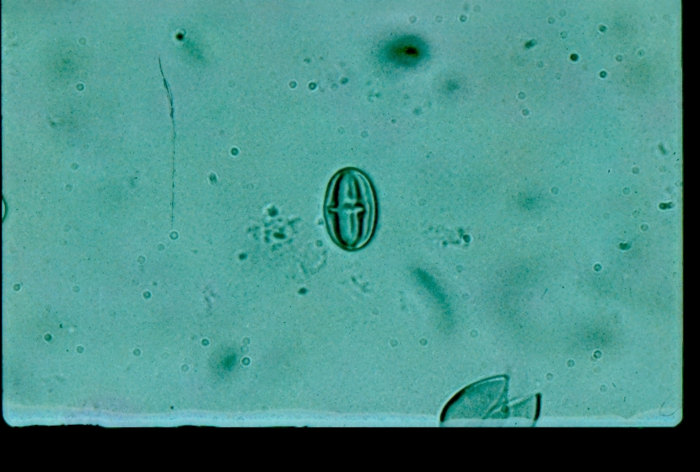
Castanea dentata (American chestnut) pollen Photo by Terryanne Maenza-Gmelch

Slide 14
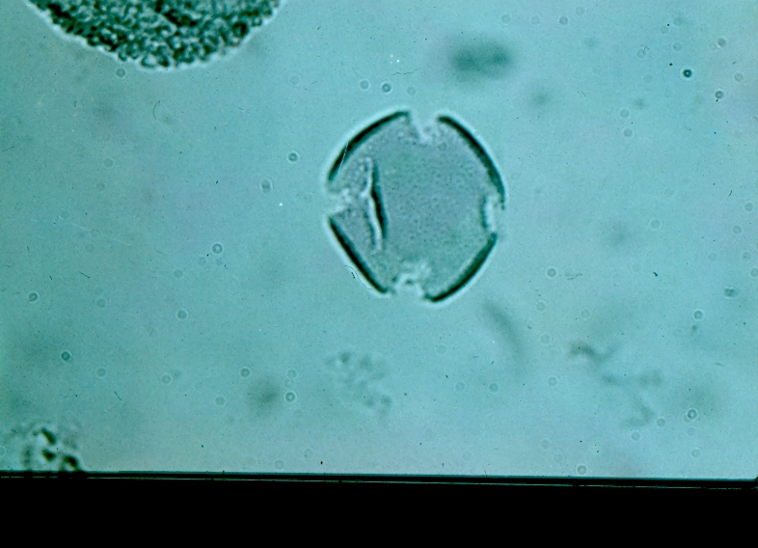
Fraxinus (ash) pollen
Photo by Terryanne Maenza-Gmelch

Slide 15
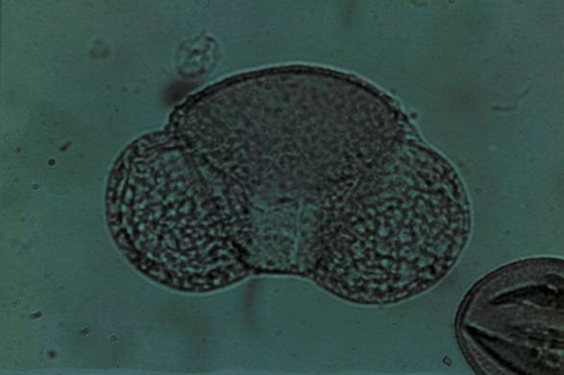
Pinus strobus (White Pine) pollen
Photo by Terryanne Maenza-Gmelch

Slide 16
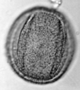
Quercus (Oak) pollen
http://pollen.usda.gov/Light_Micrographs/Fagaceae/Fagaceae.html

Slide 17
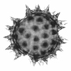
Asteraceae (herbs) pollen http://pollen.usda.gov/Light_Micrographs/Asteraceae/Asteraceae.html

Slide 18

Gramineae (Grass) pollen http://pollen.usda.gov/Light_Micrographs/Poaceae/Poaceae.html

Slide 19
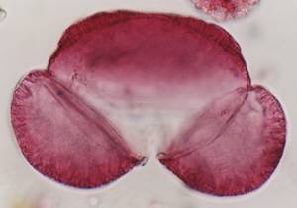
Abies (fir) pollen http://www.paleolab.ca/pollen/pollenpage.html

Slide 20
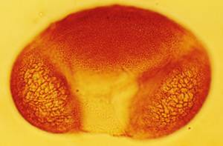
Picea (spruce) pollen http://www.paleolab.ca/pollen/pollenpage.html

Slide 21
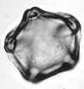
Alnus (alder) pollen http://pollen.usda.gov/Light_Micrographs/Betulaceae/Betulaceae.html

Slide 22

Cyperaceae (sedge) pollen http://pollen.usda.gov/Light_Micrographs/Cyperaceae/Cyperaceae.html

